Slide 1
Organization of 2D Space

Slide 2
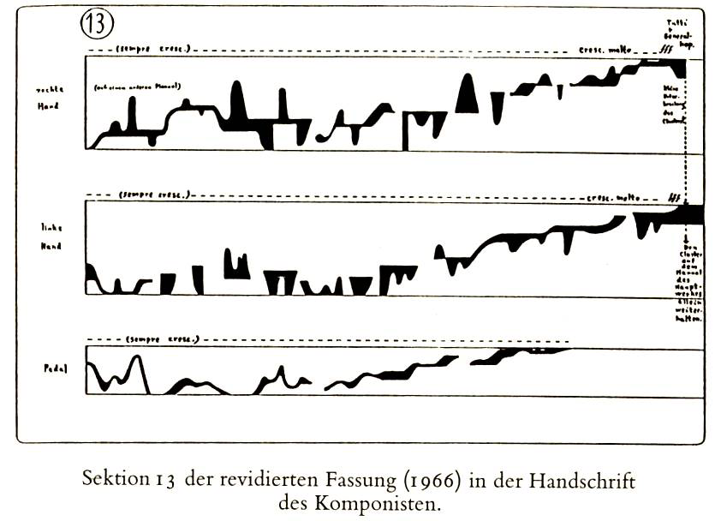
Proj 1: Linear (Ligeti musical composition)

Slide 3
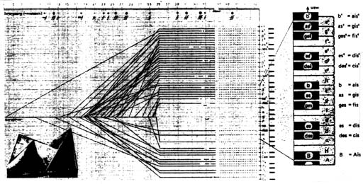
Music Notation: (Xenakis – Metastatis)

Slide 4
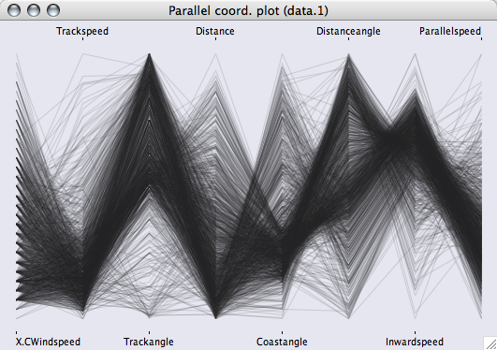
Smooth Parallel Coordinates

Slide 5
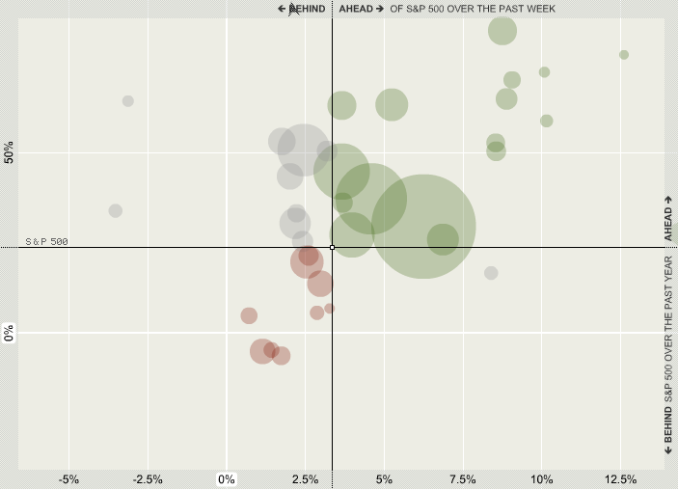
NY Times Sector Snapshot

Slide 6

Linear Relational (Audio Scrubber)

Slide 7

Art: Lisa Jevbratt (1:1 Interface)

Slide 8
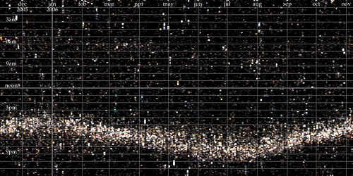
Linear Time Graphs

Slide 9
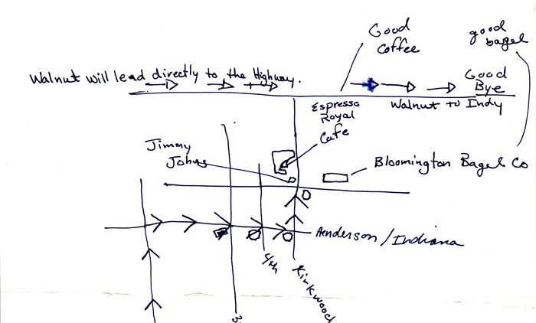
Mapping in 2D: handmaps.org

Slide 10
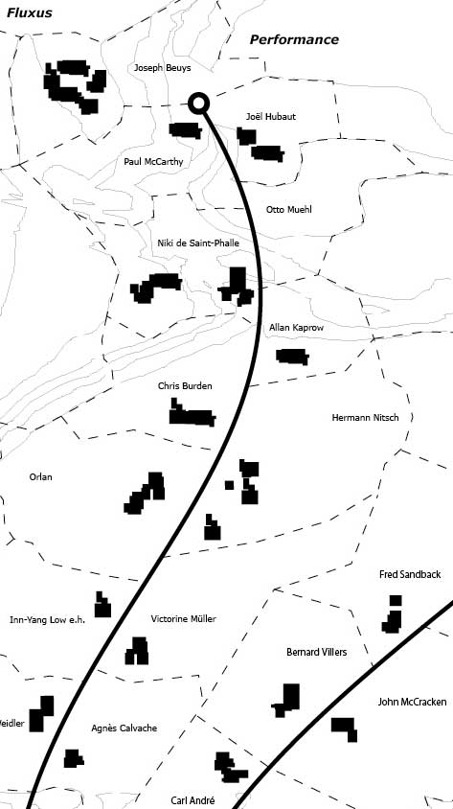
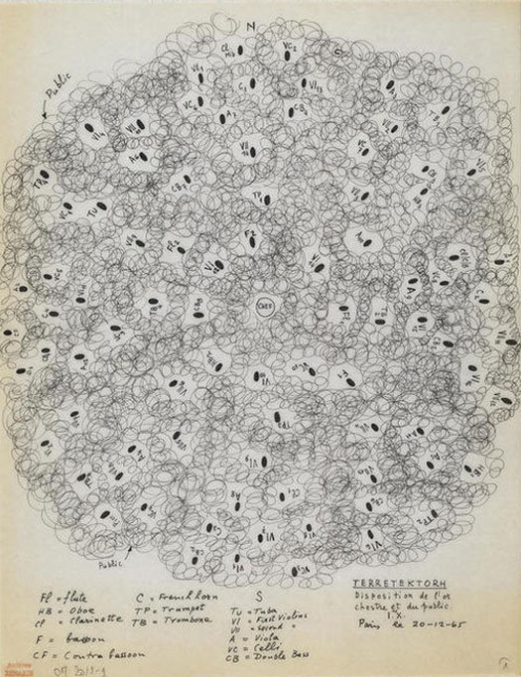
Two maps: Xenakis, Art practice

Slide 11
Visual Organization (Macro-micro, willi kunz)
M M
Space: Depending on their visual placement within a given space, the same elements will assume different visual aspects of weight and movement.
Space is visually subdivided by the tension that develops between an element and the boundaries of the space
Size and proportion of space are determined at the beginning
M
M
M M

Slide 12
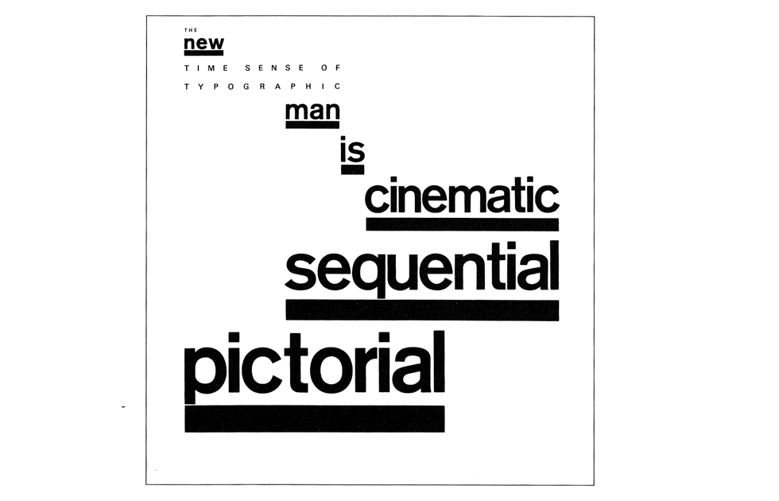

Slide 13
Motion, Movement Through Spatial Organization
A space becomes visually active when it is subdivided
Balance is achieved through interplay of scale, sequence, and spatial position
Any object placed next to each other in an image defines a relationship through spatial proximity

Slide 14
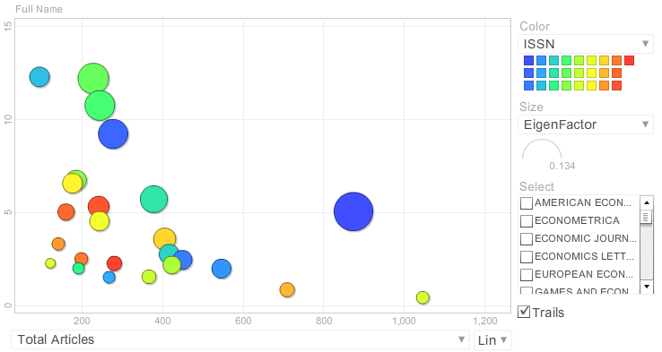
Positioning in 2D Space: Eigenfactor.org

Slide 15
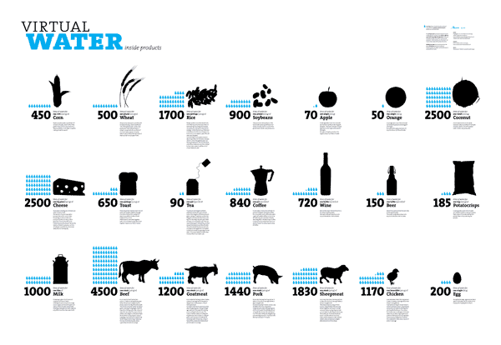
Mosaic Grid: Structure determines order

Slide 16
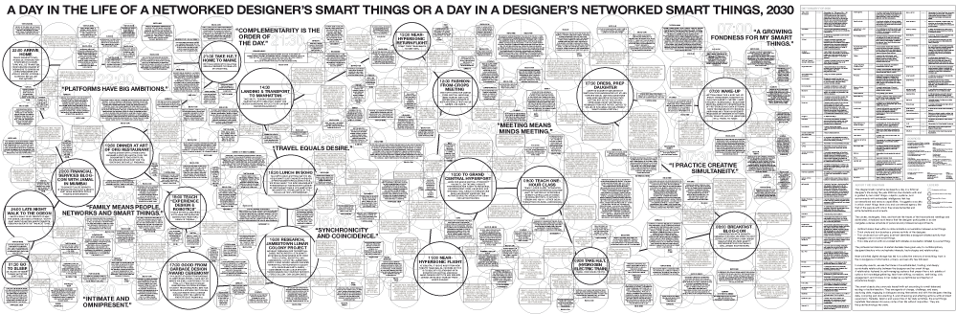
Node Mosaic

Slide 17
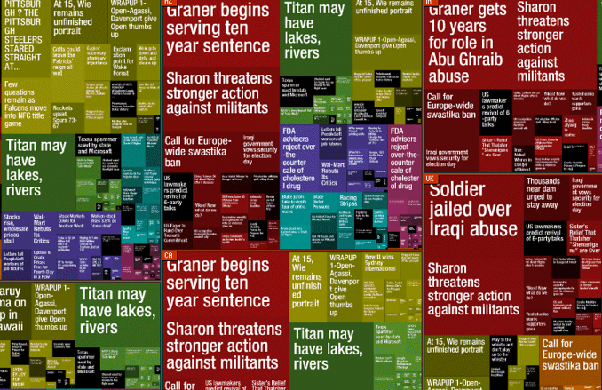
TreeMap: Values determine order Newsmap

Slide 18
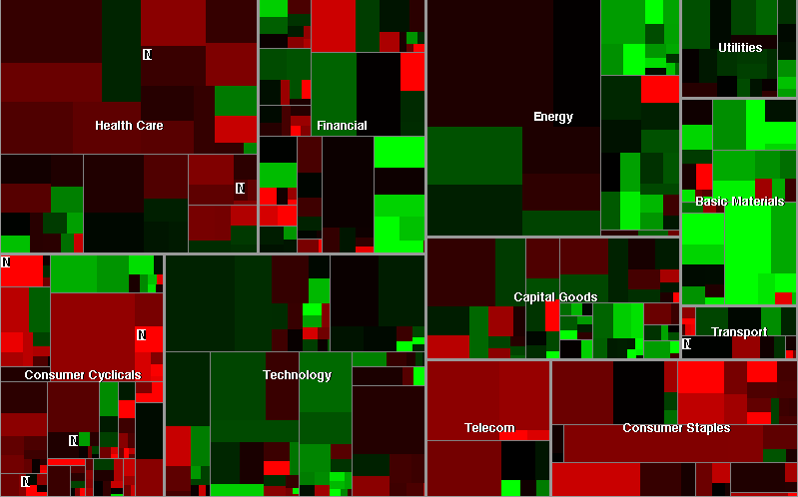
TreeMap: SmartMoney

Slide 19
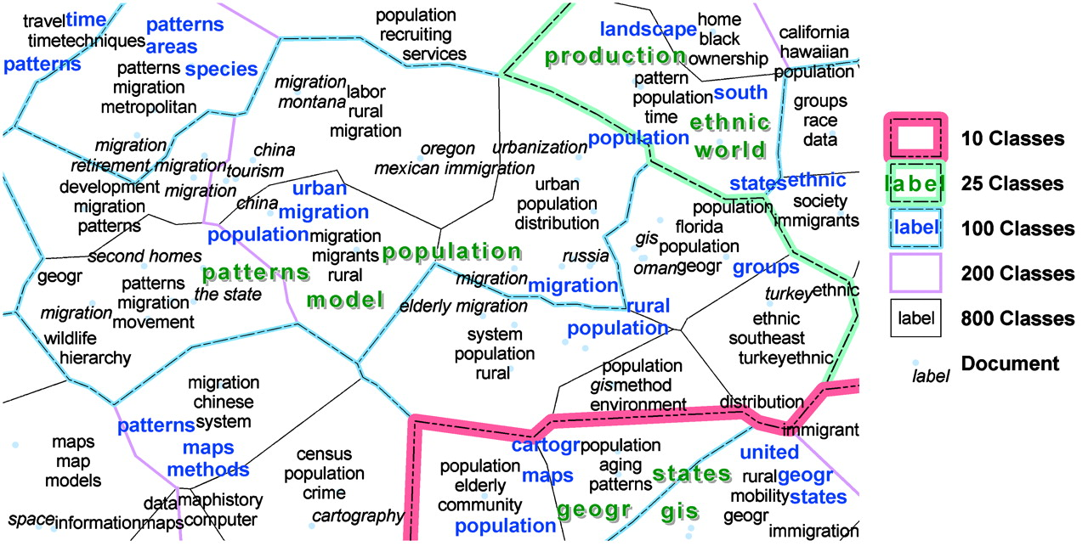
Visualizing knowledge domain spatially using Kohonen (Skupin)

Slide 20
Visual Basic Literacy: Basic Units(Dondis)
Dot: Minimal unit, pointer, marker of space
Line: Joins dots, articulator of space
Shape: Line describes and encloses space
Direction: Thrust of movement
Tone: The intensity of lightness or darkness
Color: Associative and symbolic meanings
Texture: Quality of touching, looks/feels like
Scale: Relative proportion & measurement
Dimensions: 2D, 3D spatial illusion
Motion: Visual elements guiding the viewer

Slide 21
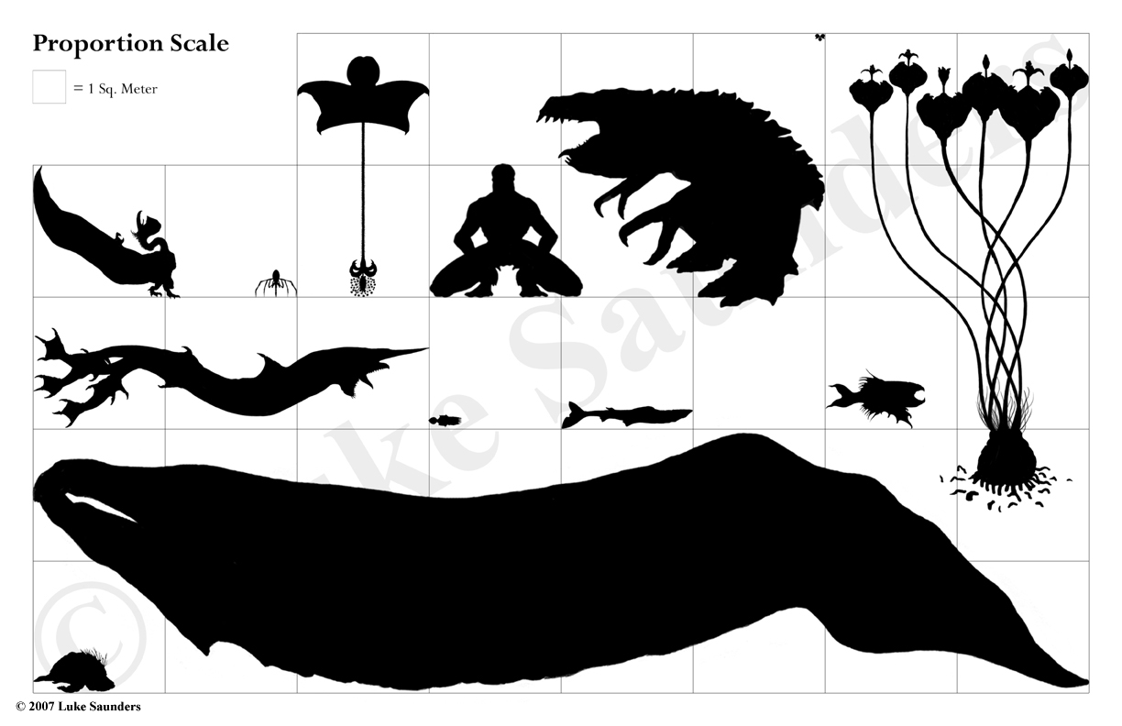
Scale: Relative proportion & measurement

Slide 22
Visual Language & Syntax
M M
Visual language: Analogous & symbolic
Visual Syntax: partially perceptual, partially conventual (cultural, learned)
Images represent. (They are abstracted information)
Meaning is constructed (assembled parts)
Visual Language therefore requires apprenticeship (What you see is what you know)
2 Layers: Denotative: (literal message), Connotative (implied sub-text)
M
M
M M

Slide 23
Weight, Im/Balance, Dis/Order, Un/Stable
M
M
M
M
Balance: Physiological, psychological
  H-V construct: man to his environment
Stress: Unstable causes stress
  Stabilization: relative stress/balance
Lower-left: most stable
Harmony: (centered), no visual surprise
  Search for balance with off-center mark
Ambiguity: may obscure intent & meaning
  Slightly off-center mark confounds
Visual elements in stress location: more weight
M
M
M M

Slide 24
Groupings
•
•
Attraction & Grouping: 2 dots fight for attention in their interaction
Distanced: Create individual statements as they repel each other
Close together: The more complicated the forms they describe - There is an attraction force
Perception: dictates to make whole out of units
  Connect the dots!!
  Visual phenomenon for astronomical signs
Opposites repel, similars attract
• •
•
• •
•
•

Slide 25
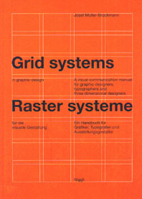
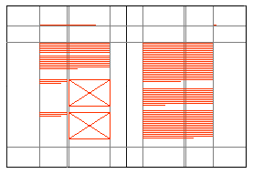
Structure: the Grid System
Modular Grids: Modules determine the dimensions and placement of graphic and typographic elements
All elements are consistently placed according to the pre-determined structure once it has been defined
The grid functions as an organizational device, but stays invisible
Structural order also requires imagination
Design process: begin with intuition and visual judgement, follow with rational structure

Slide 26

Spatial Organization & Hidden Modular Grid
Development of a grid must proceed from
an evaluation of all the visual material to be included in the design

Slide 27


